Slide 1
Be Unique

Slide 2
17 Insights On What Makes A Person Unique
Know that you already are unique.
Be confident.
Be dependent on nothing.
Find your values.
Fight your insecurities.
Determine your goals.
Be aware of your own emotions.
Know your opinions, while being open to suggestions.
Have the power to think independently.
Stop playing games.
Dress for yourself.
Stand up for yourself.
Let haters hate.
Try new things.
Educate yourself.
Make a target of yourself.
Do things that you sincerely enjoy.

Slide 3
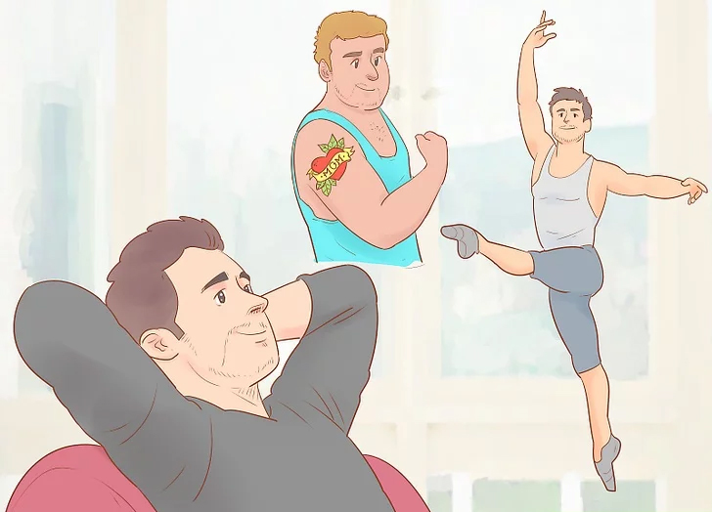
Know that you already are unique.
The fact of the matter is that we humans are pretty similar. Very few of us are true outliers. We all eat, and feel the same spectrum of emotion. However -- we, as individuals are unique. Not one of us is the same as anyone else because we are a combination of experiences, personality, and outlook that no one else has ever had or ever will have. If you want to be unique, congratulations. You already are.

Slide 4
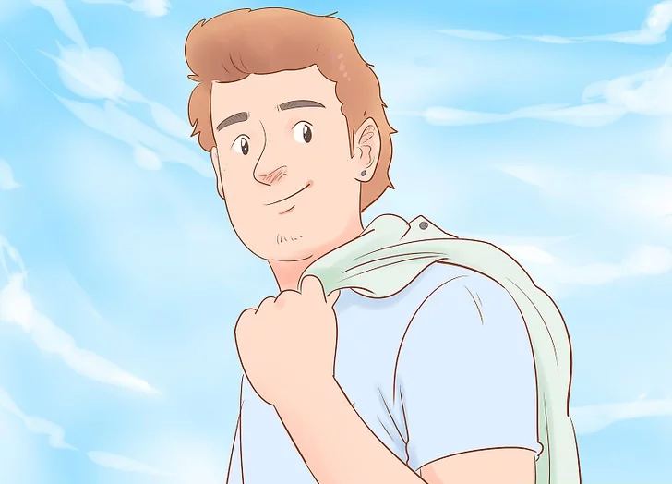
Be confident.
Heads up: this entire article is going to be about making your own decisions and making sure your decisions are your own. In order to do that, you gotta be confident. First thing. If you're second-guessing your every move and looking to other people or things for direction, you're not you. The only thing in this world that is unique is you, so get on that.

Slide 5
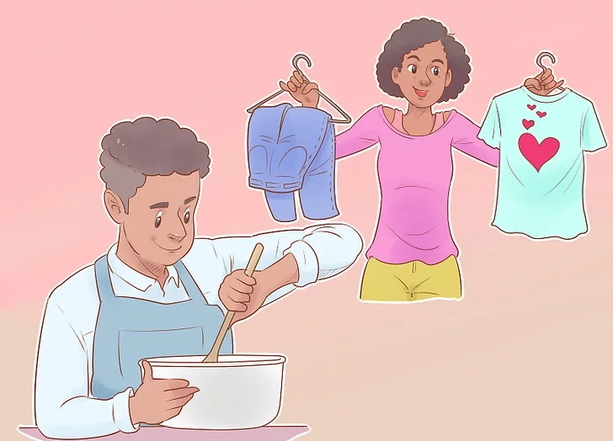
Be dependent on nothing.
This one is hard -- as a human (and especially in today's society), we naturally thrive in a group. But to the extent that it's possible in your own life, see that you can live without plenty of things. For starters, that means no addictive habits. That just takes away from you, controls your urges and controls your emotions. No thank you.

Slide 6
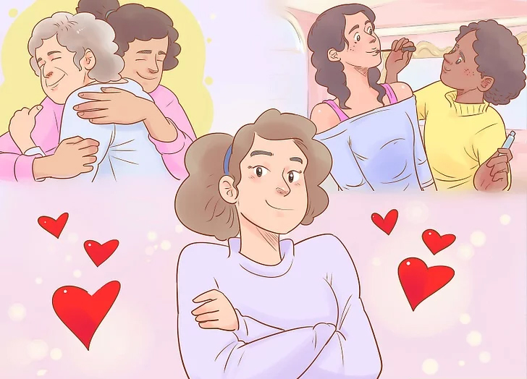
Find your values.
we gotta find out just who you are. Do you know? Hopefully, because no one else does! What do you value across the board? In friends? In relationships? In products? In human culture?
When you come up with a list of 10 or so things, these are what you should strive to be. These are not labels -- these are good qualities that are important to you. Whether it's honesty, justice, or high-quality denim, it's saying something. It's pointing you in the direction of your uniqueness.

Slide 7
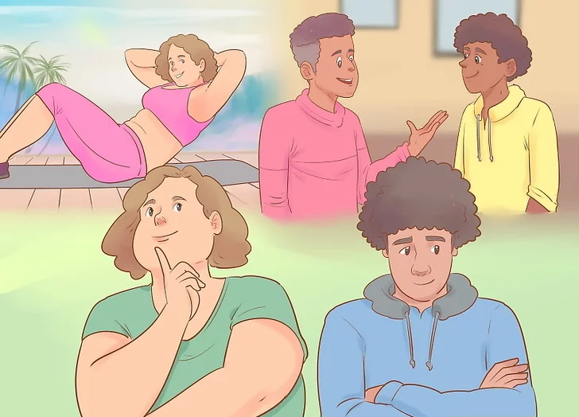
Fight your insecurities.
Another unfortunate aspect of being human is that at some point in our childhood, we become aware of others' judgment. Someone makes fun of our My Little Pony folder and it gets tossed in the trash. This sucks and it's totally unnecessary, but inevitable. We start developing insecurities and they take over. We become afraid of people and their words. Think about how silly that sounds!

Slide 8
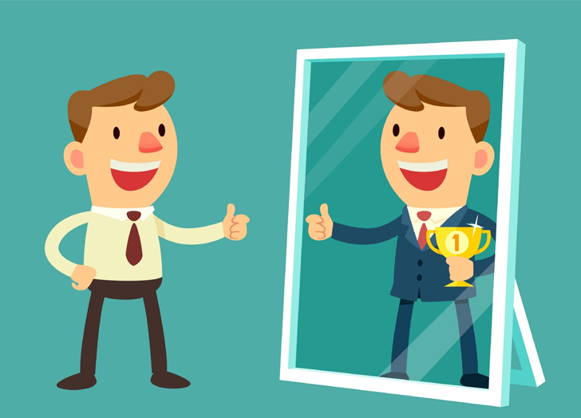
Determine your goals.
After you've determined your core values, it's time to get to your goals. What do you want to be? What do you want to do? How do you want to feel every day? Now, how might you accomplish these things?

Slide 9
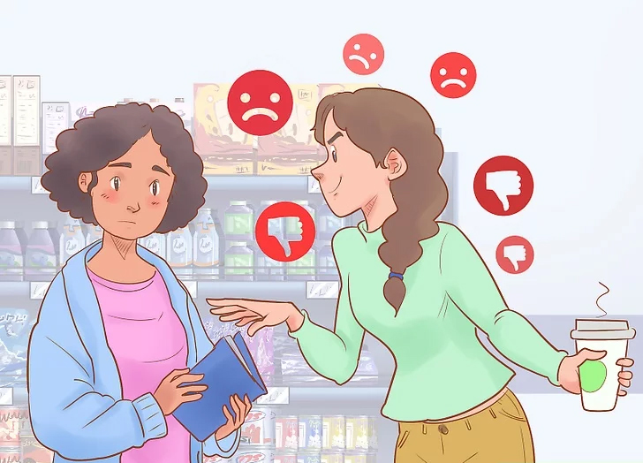
Be aware of your own emotions.
The keyword here is "your own." Okay, two keywords. Try not to be influenced by other people's emotions; spending too much time thinking about other people's thoughts can lead you away from your own. Most emotions are contagious -- how do you actually feel?

Slide 10
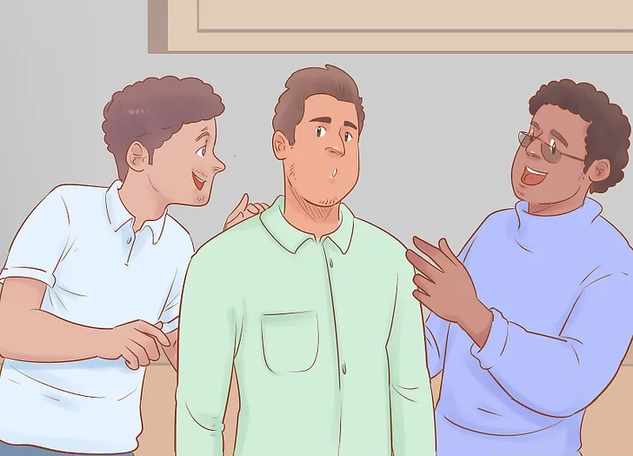
Know your opinions, while being open to suggestions.
Don't say something for the sake of saying it. Instead, take a moment after a conversation starts to think about what you know and what resonates with you, then begin talking. Try to listen to what other people are saying without being sucked in, and without immediately casting aside their ideas. An engaging debate can be fun, stimulating, and teach you a lot about your own values.

Slide 11
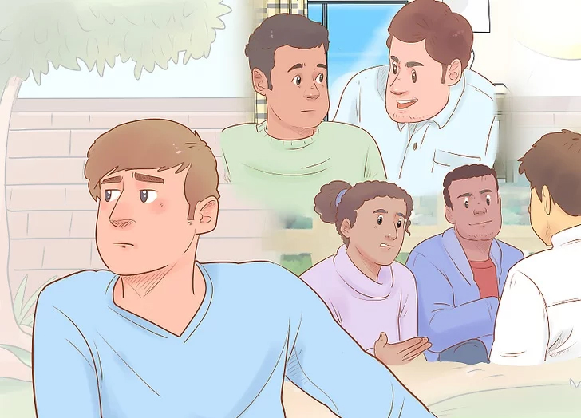
Have the power to think independently.
Don't give in to peer pressure, whether it be your parents, friends or teachers. Be skeptical and explore ideas for yourself. As the Syfy channel, George Carlin, and a bajillion others have said, "Question everything." Whether it's your religion, your take on democracy or your feelings toward Brussels sprouts (maybe you actually like them...), think about it. What was handed to you and what's something you've actually given thought to?

Slide 12
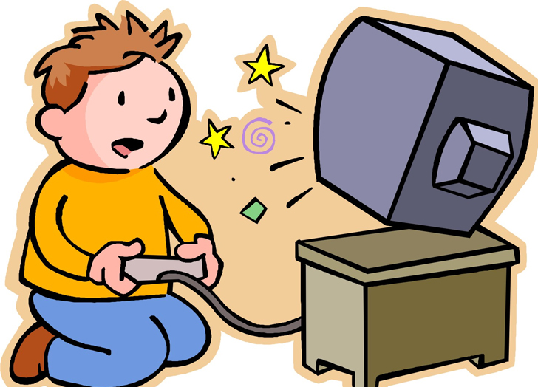
Stop playing games.
So we talked about fighting your insecurities and how insecurities lead to games. Those games need to stop! They're a direct result of people telling you how to behave or instilling some worry in you that's keeping you from your actual desired behavior. Instead, take that list of values you have and take a deeper look. How might you act if you embodied those values in all your actions?
By games, if it wasn't clear yet, we mean saying or doing one thing and meaning another. When you say, "God, I'm so fat. I can't believe it," you're actually saying, "I feel fat. Please tell me I'm not." Some of these games are asking for attention, some of these games are manipulative, some of these games are just seeking information, but either way, they're not you. So there's no place for them in your uniqueness.

Slide 13
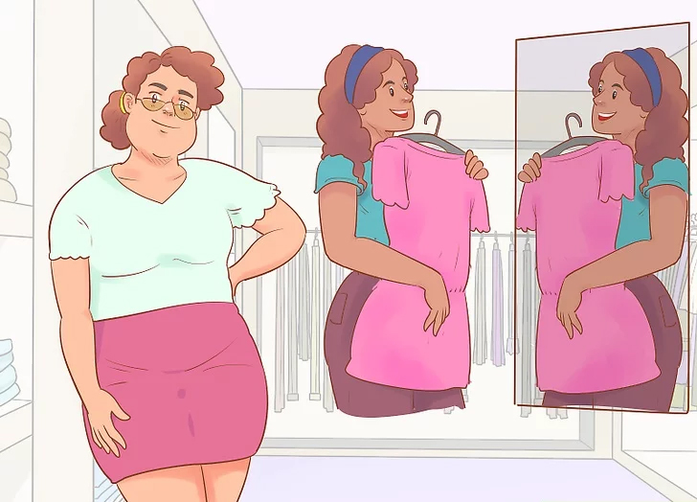
Dress for yourself.
Avoid trying to dress to please others. If you follow fashion trends that you don't actually like, it will be harder to make connections because you'll be wearing a false shell. Instead, dress to suit your personality and your tastes. Why would you do anything other than that?

Slide 14
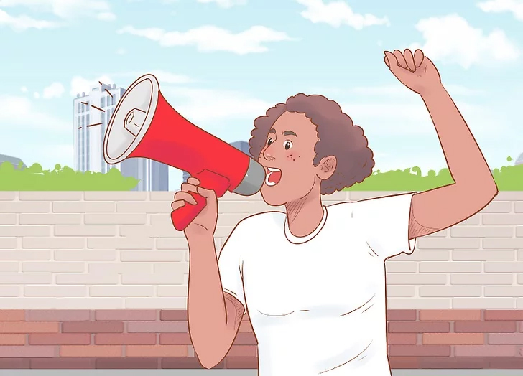
Stand up for yourself.
When the time comes for an opinion (and those times crop up often), standing up for yourself must be done to showcase your individuality. How can you be unique if you don't stand for anything? As Katy Perry eloquently puts it, "I stood for nothing, so I fell for everything."

Slide 15
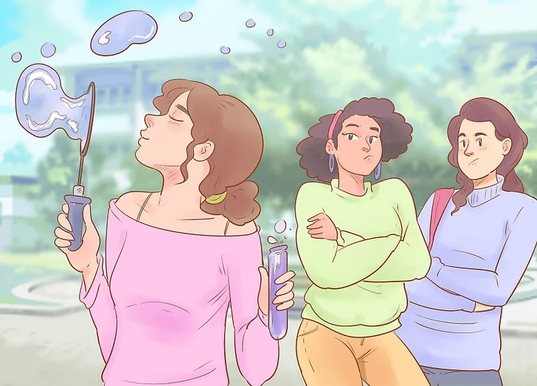
Let haters hate.
There are gonna be haters. There are always gonna be haters. And that's awesome! Having haters means you're doing something. You're out there and doing something that someone doesn't approve of. Fantastic! How better to do something and be hated than doing nothing at all. And you know what? That's no skin of your nose. Let them handle their negativity. It has nothing to do with you.

Slide 16
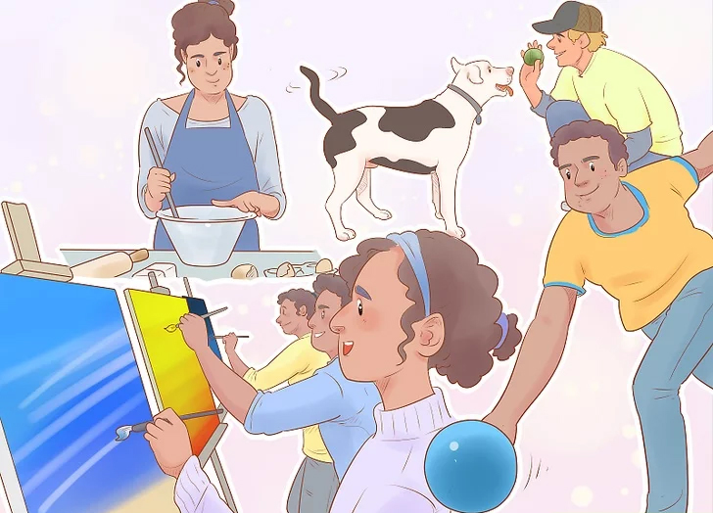
Try new things.
In the same way that you should be open-minded to others' opinions, you should be open to new activities! As children, we are often stuck only exploring the world our parents present for us. When we grow up, we need to explore for ourselves, finding what we actually do and do not like. You can't have opinions on things you know nothing about -- and no opinions, no preferences? That's definitely not unique.

Slide 17
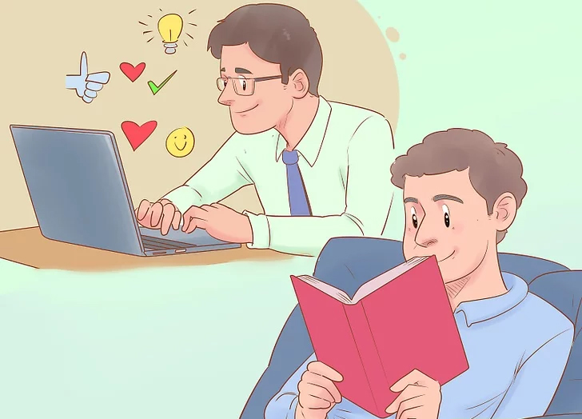
Educate yourself.
Along with trying new things, learn new things, too! There's an entire world out there that you don't know about (many, actually). Pick up a book that you'd never otherwise give a passing glance. Spend an hour on wikiHow looking at random titles. Expanding your horizons will introduce you to things you didn't even know you enjoyed.

Slide 18
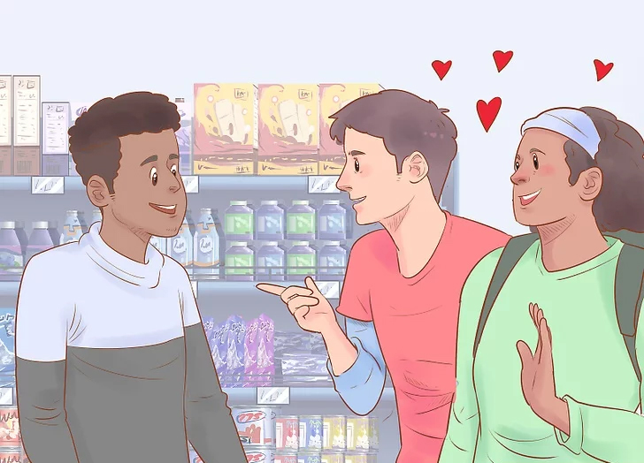
Make a target of yourself.
A while ago we mentioned how haters only exist when we actually do things. We talked about how the haters shouldn't affect us -- now we're talking about actually attracting them. Not purposefully; they'll show up on their own when you do something notable. So make a target of yourself by doing something that puts you out there. Some people will love it and others will hate it. Cool.

Slide 19
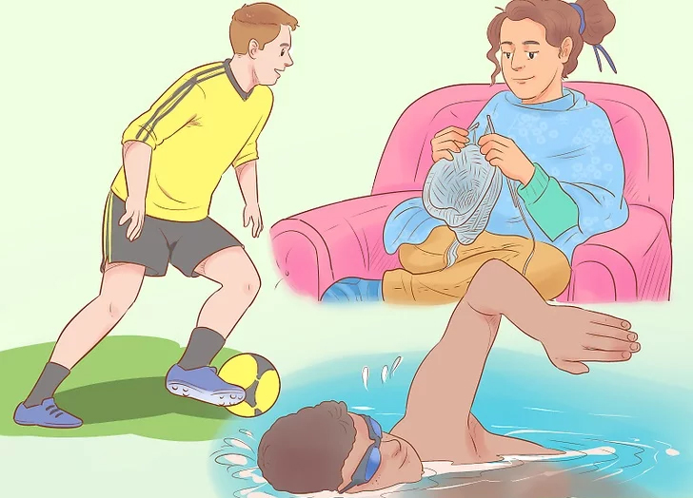
Do things that you sincerely enjoy.
Try a hobby or a sport that you've been wanting to participate in. When you do the things you love, you tend to meet people that are more in tune with you and will be compatible friends in the long run. And you'll be happier, too. All of a sudden everything will seem to jive.

Slide 20
Conclusion
Notes:
In Slide Show mode, select the arrows to visit links.

